Slide 1
CSCE 310 Recitation
TA: Kang-il Park

Slide 2
Getting Started with C++
C++ will be the programming language used for CSCE 310
Suggested IDE: Visual Studio Code (but you can use your preferred IDE/Text editor of choice)
https://code.visualstudio.com/docs/languages/cpp

Slide 3
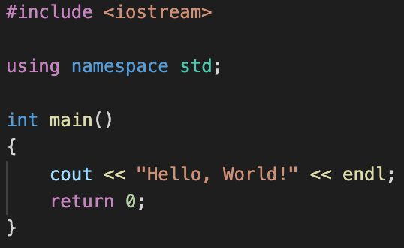
“Hello World” in C++

Slide 4
“Hello World” in C++
Functions will always use this namespace first

Slide 5
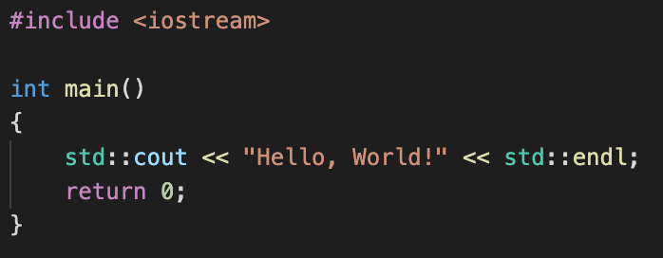
“Hello World” in C++
Otherwise, you’d be calling std:: all the time!

Slide 6
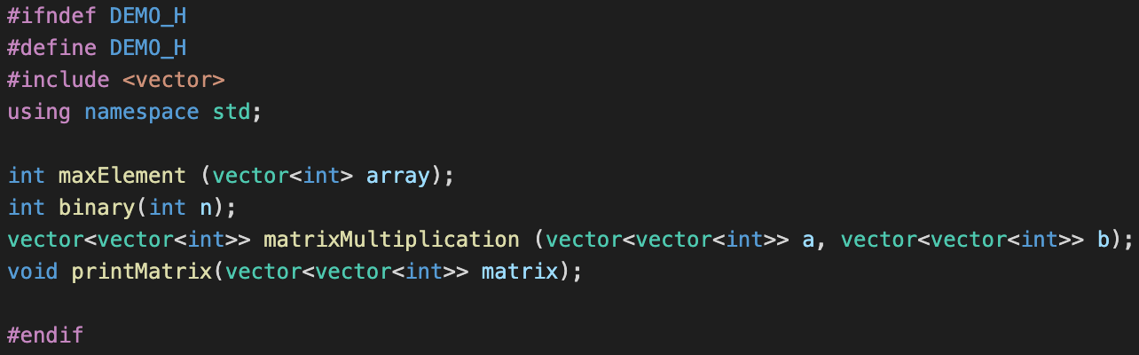
Header files in C++

Slide 7
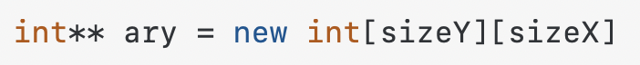
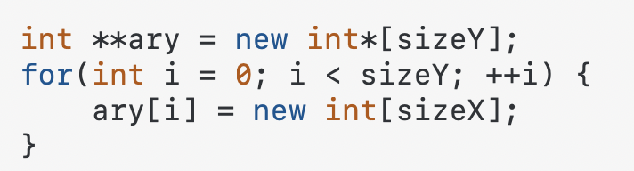
Arrays in C++

Slide 8
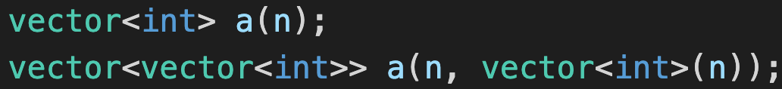
Instead, we can use Vectors in C++
Accessing element of a vector: a[x]
Returning size of a vector: a.size()
Two-dimensional vectors: ”vector of vectors”

Slide 9
Terminal Commands for this Activity (CSE or Local)
For basic Unix commands:
https://www.linuxjournal.com/content/linux-command-line-interface-introduction-guide
Compile code:
g++ -std=c++14 -o ./demo.out ./*.cpp
Run compiled code:
./demo.out

Slide 10
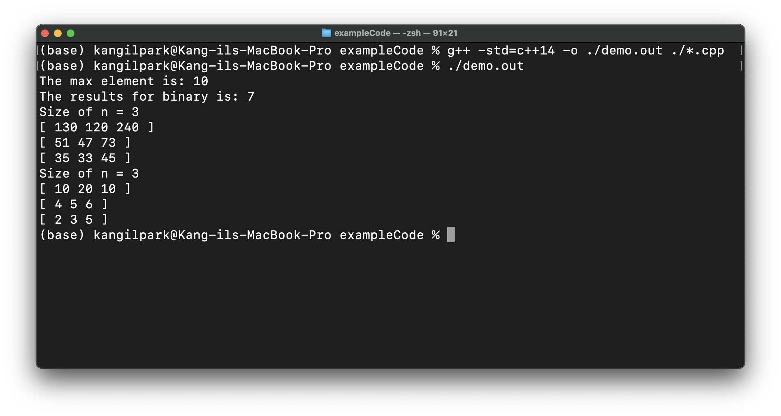
How do you run C++ code natively?
Linux/macOS: g++ should work on in the terminal natively
Windows: Follow directions on https://code.visualstudio.com/docs/languages/cpp or install the Windows Subsystem for Linux (openSUSE, Ubuntu, etc. on Microsoft Store)
Completed program should have output like this

Slide 11
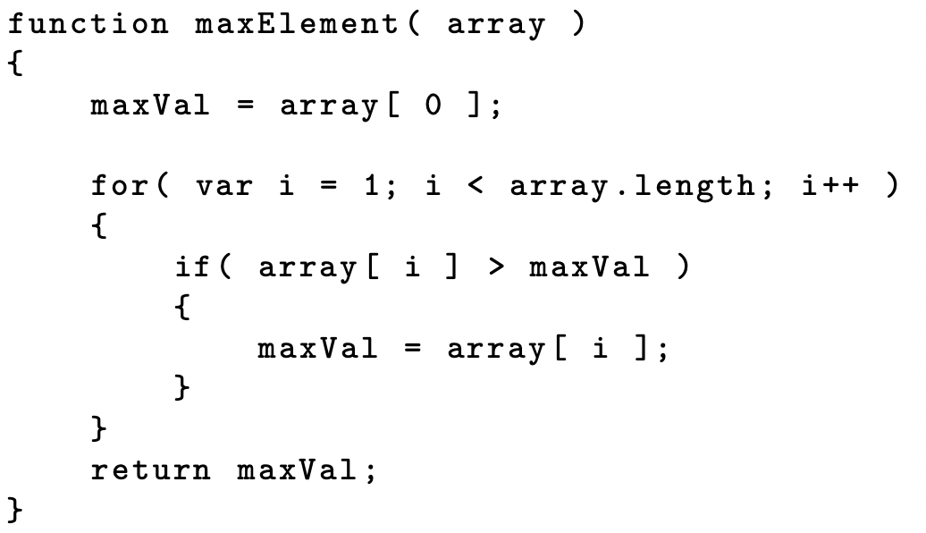
For this Recitation
Implement the 3 algorithms from class

Slide 12
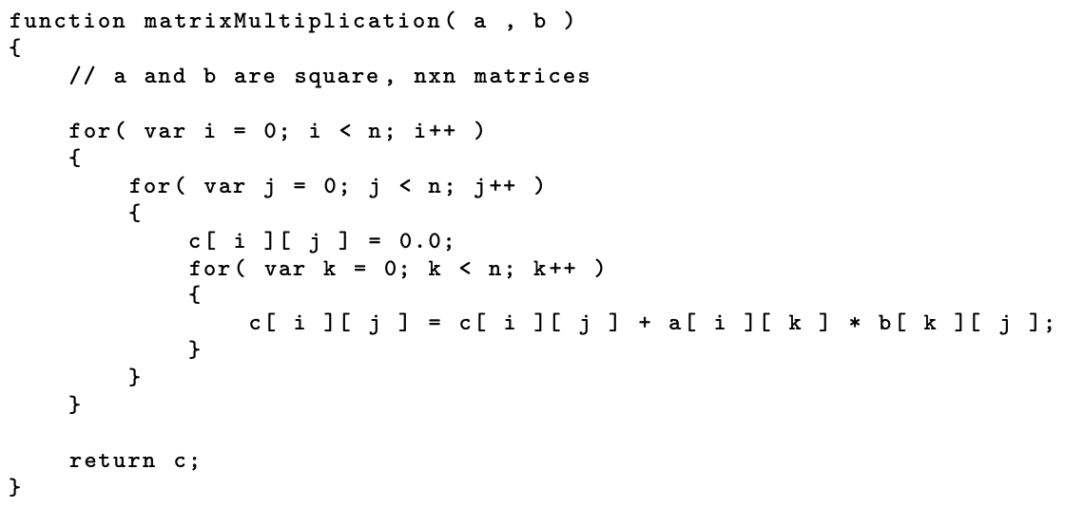
For this Recitation
Implement the 3 algorithms from class

Slide 13
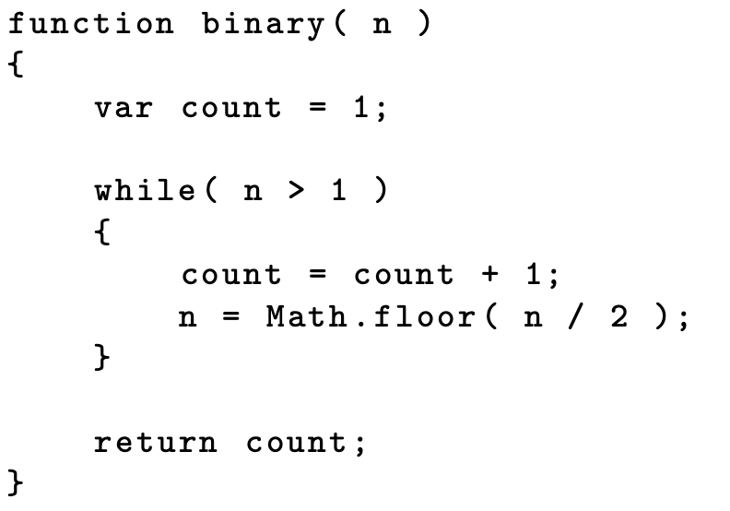
For this Recitation
Implement the 3 algorithms from class

Slide 14
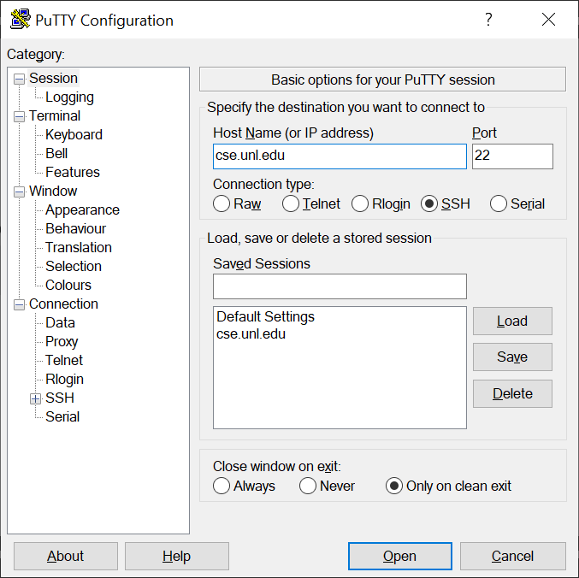
Quick Reminder: Connecting to the CSE Server
SSH (such as PuTTY): cse.unl.edu
Used to compile and run uploaded code
FTP address (to upload files to the CSE server):
sftp://cse.unl.edu
Used for uploading files (with an FTP client such as FileZilla)
Use CSE login for both instances (Not UNL)

Slide 15
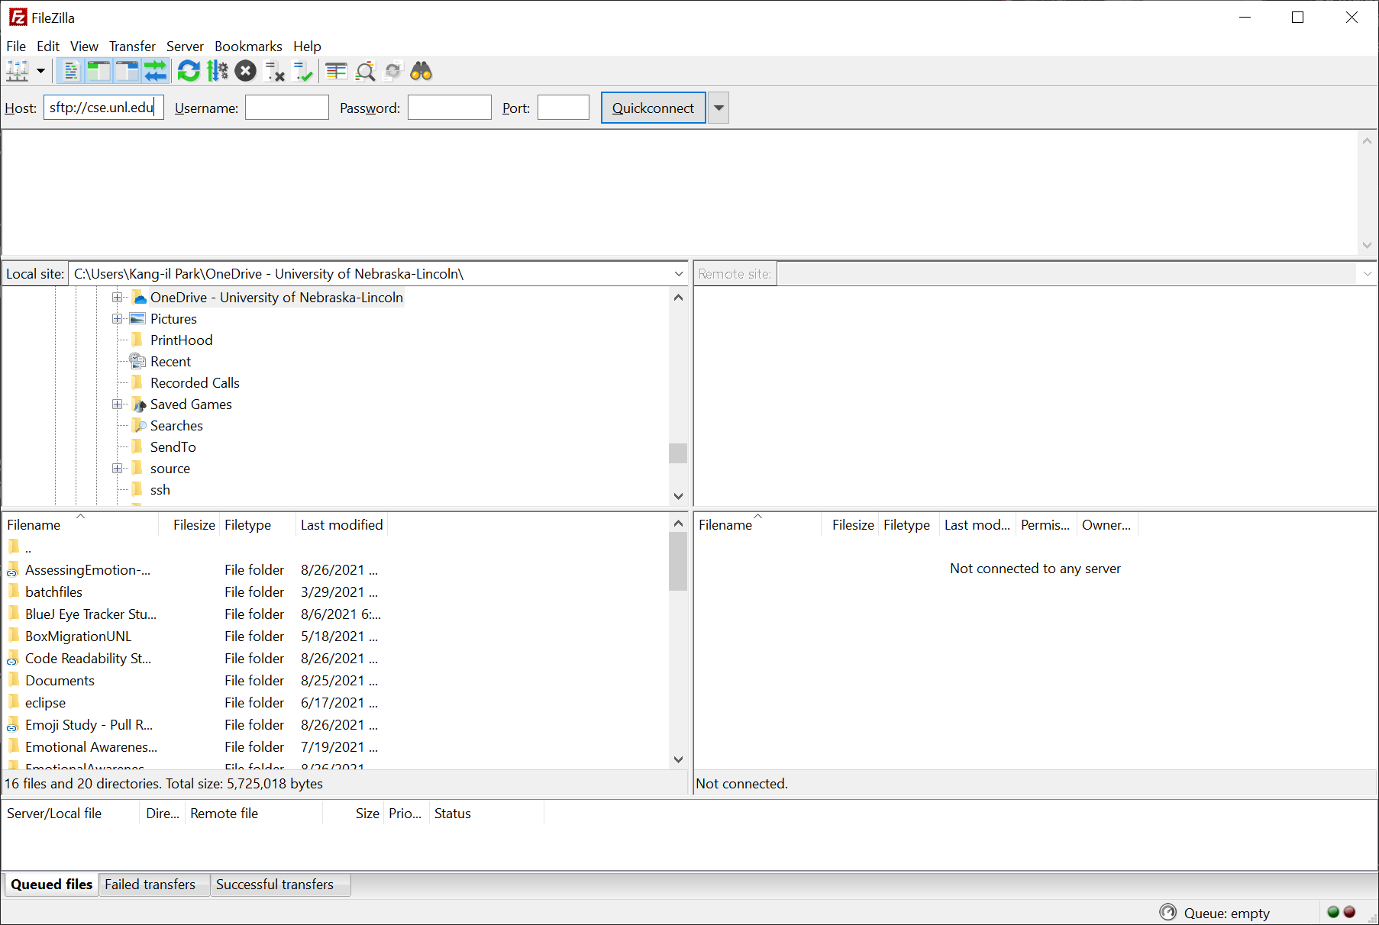
Quick Reminder: Connecting to the CSE Server
SSH (such as PuTTY): cse.unl.edu
Used to compile and run uploaded code
FTP address (to upload files to the CSE server):
sftp://cse.unl.edu
Used for uploading files (with an FTP client such as FileZilla)
Use CSE login for both instances (Not UNL)

Slide 16
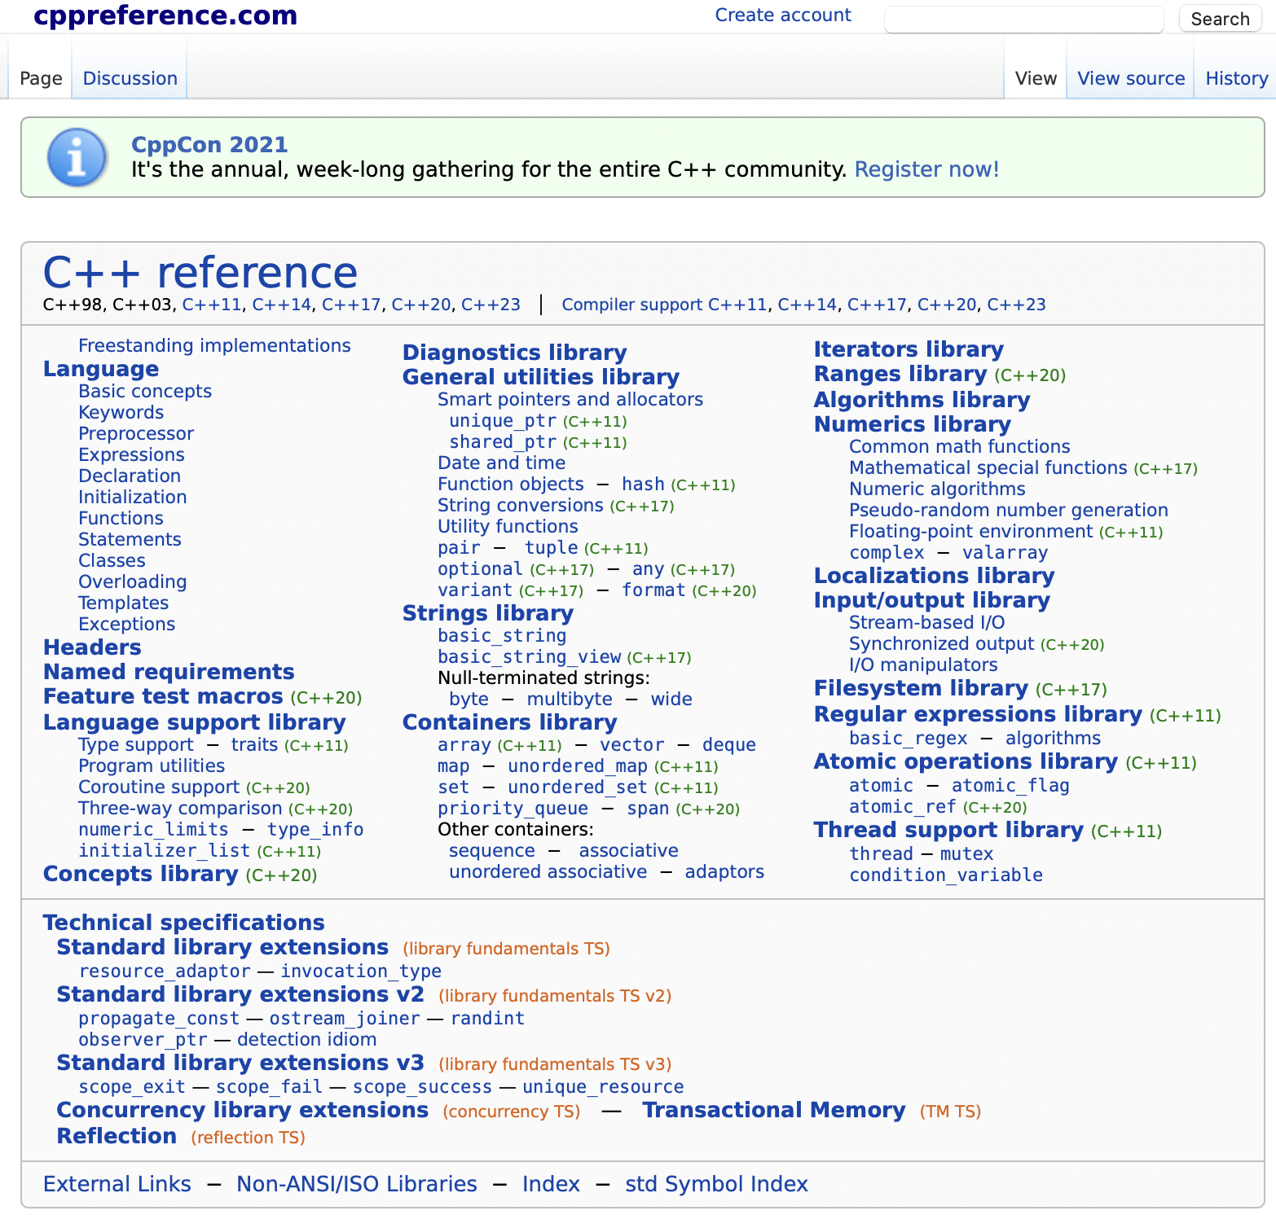
References to Consider
https://en.cppreference.com/w/
https://www.cplusplus.com

Slide 17
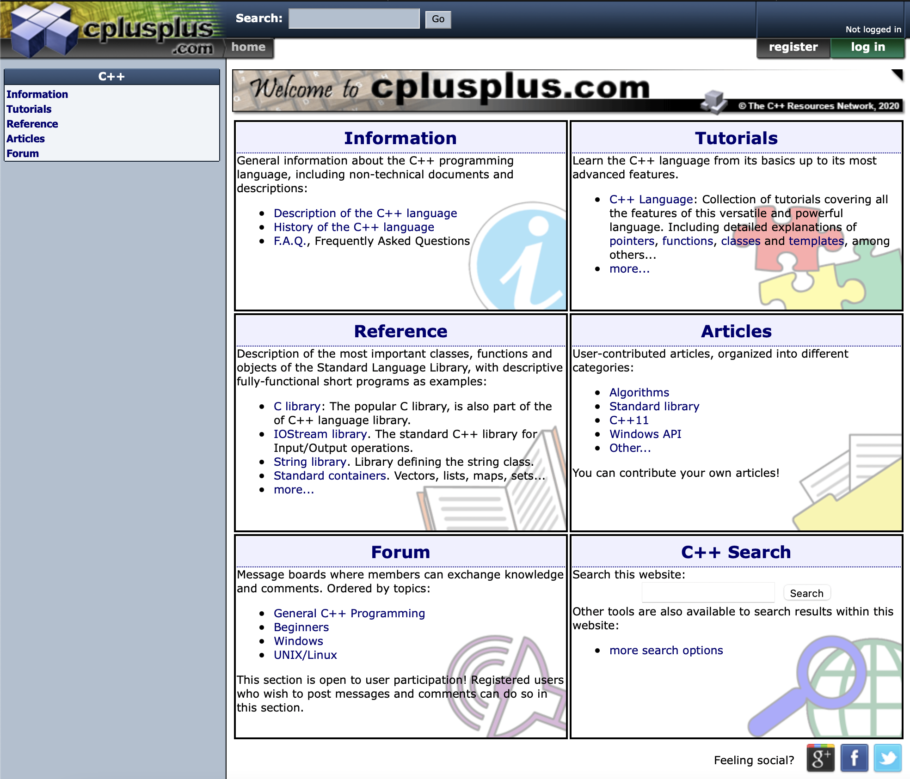
References to Consider
https://en.cppreference.com/w/
https://www.cplusplus.com

Slide 18
Starter Code and this Presentation
Can be found at:
https://github.com/KangilPark/310cppIntro
This PPT will also be on Canvas

